Slide 1
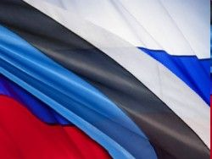
Modern problems of European union countries' integration policy: THE CASE OF ESTONIA
Dr. Olga Khalliste

Slide 2
Population in the ER
1897 г. - 46 026 Russians and 884 553 Estonians.
1917 г. - approximately 100,000 Russians.
1991 г. - share of Russian-speaking population has grown according to various sources 30-36% (1 million 726 thousand of ethnic Russians).

Slide 3
The first step 1991–1995
1992 - Estonian government declared valid citizenship legislation from 1938.
Permanent residents (citizens ESSR), who were not citizens of Estonia on July 16, 1940, or the descendants of those, suddenly became a foreigners.
Russians begin to be viewed not as historical minority, but as a heritage of the Soviet occupation concerning which approach from the point of view of the established minority rights is unacceptable
Course for re-emigration of non-Estonians, the policy of “platform cleaning”.

Slide 4
The second step 1996–1999
EU and NATO pressure
1996 – the Parliament ratified the Council of Europe Convention for the Protection of Ethnic Minorities. The relevant law was adopted, but with the proviso that minorities can be considered only in case they are a citizens of Estonia.
1998 – the Government approved “The Integration Foundation”.
1999 - the Government adopted the first “State Integration Programme for 2000-2007” (http://www.rahvastikuministeerium.ee), which had the main objective studying of Estonian language by ethnic minorities. There were linguistic-communicative, political and socio-economic targets in the program .

Slide 5
The third step 2000-2007
Implementation of the “State Integration Programs for 2000-2007”
The education system is considered as one of the key factors in the integration process. On the one hand, participants of the integration process improve their language skills, with another, socialization is regulated through language training , and the habit to coexistence of two cultures is created.

Slide 6
“State Integration Programs for 2000-2007” criticism
Lack of attention to national identity of people
National identity is the result of emotional and cognitive processes of ethnicity’s understanding, an individual identification with members of one’s own ethnic group and isolation from others, as well as a deep personal significant experience of ethnicity. Identity formation and development consists in the synthesis of identifications that are integrated into the system of the integral identity components.
National identity with all its components is important sign for the nation resilience.

Slide 7
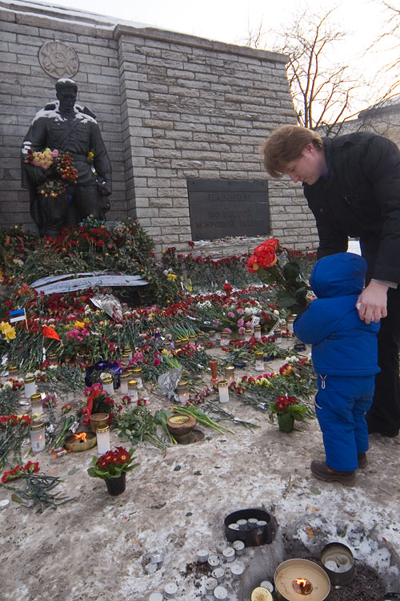
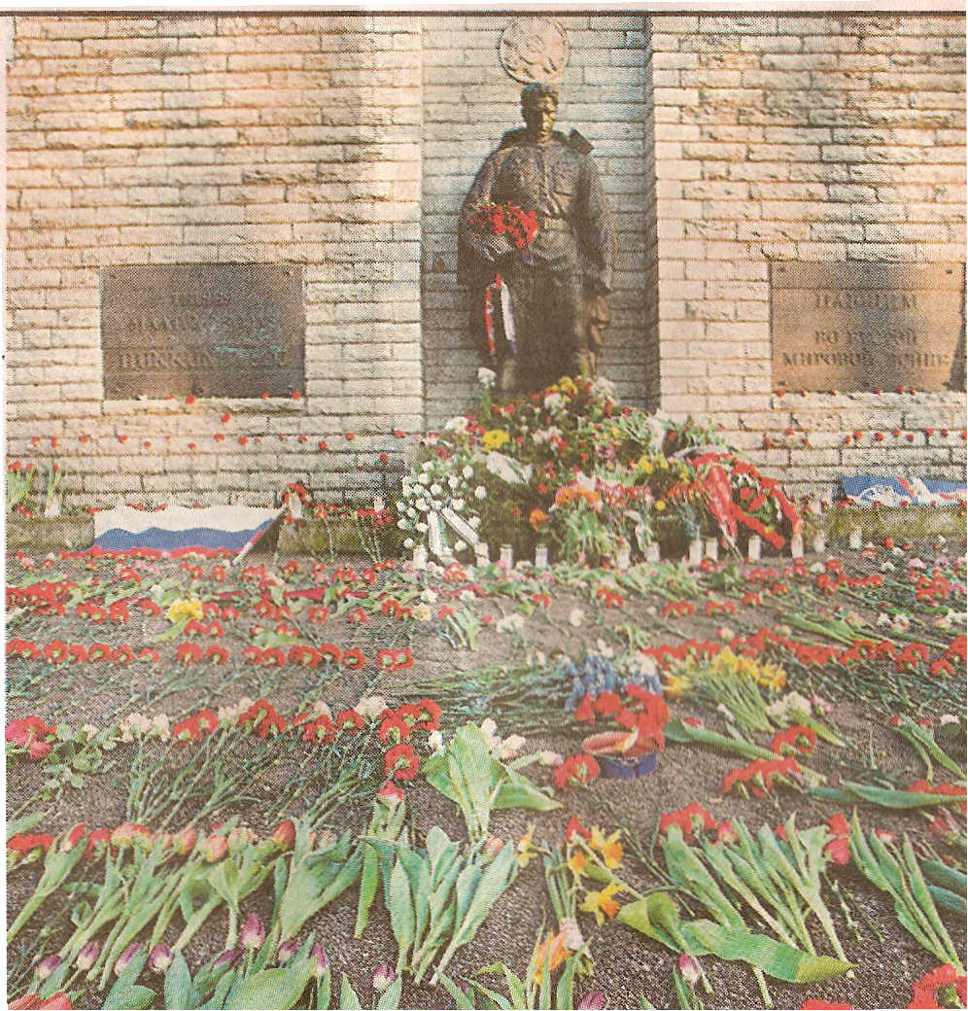
“Bronze night” events
So name "Bronze Soldier" (Monument to the Liberators of Tallinn) as well as become a symbol of the Soviet "occupation" for Estonians became a symbol of national identity for Russians living in Estonia.

Slide 8
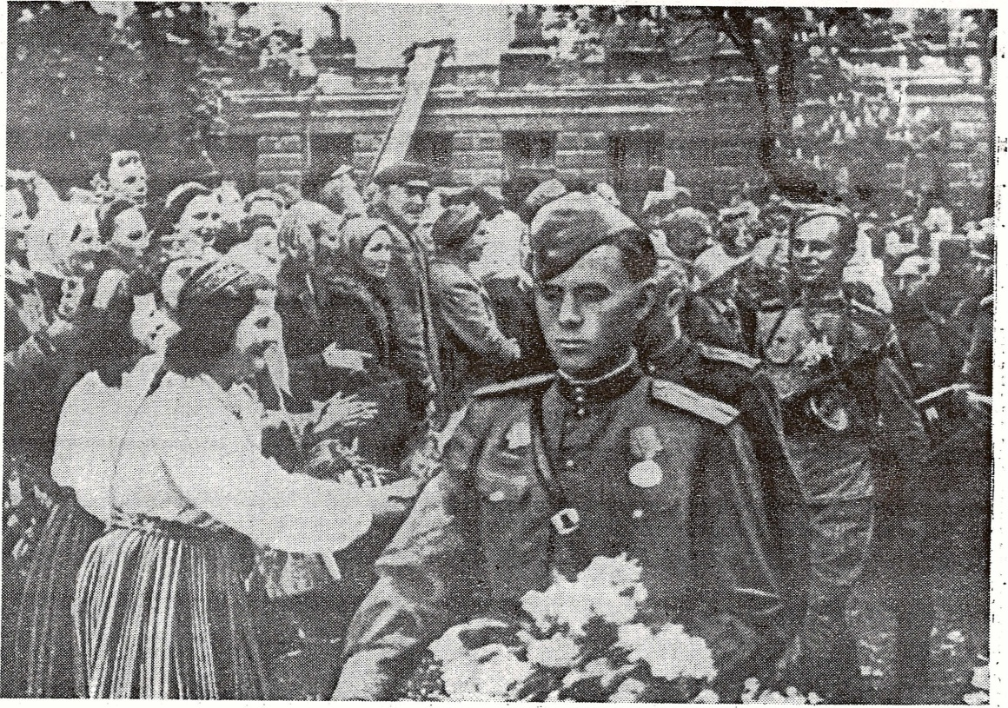
“Occupation” of Estonia

Slide 9
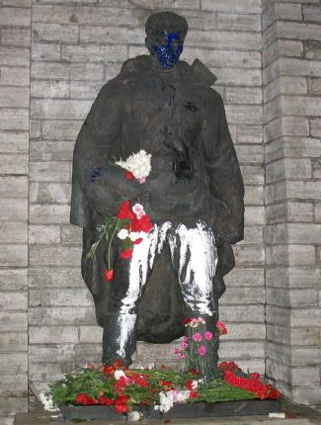
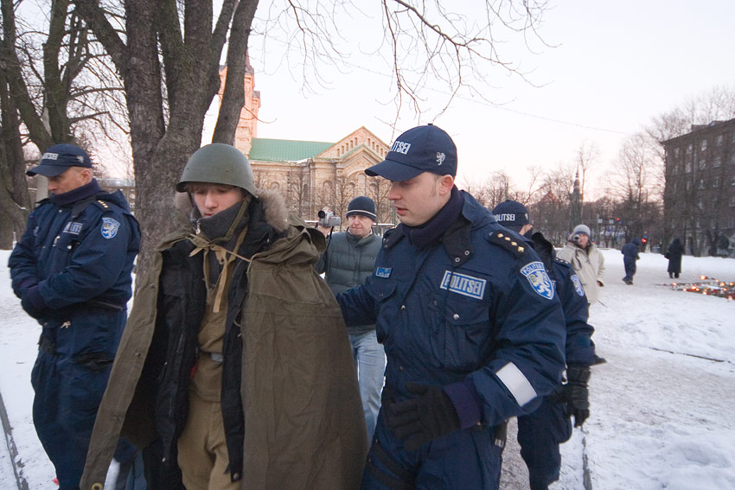
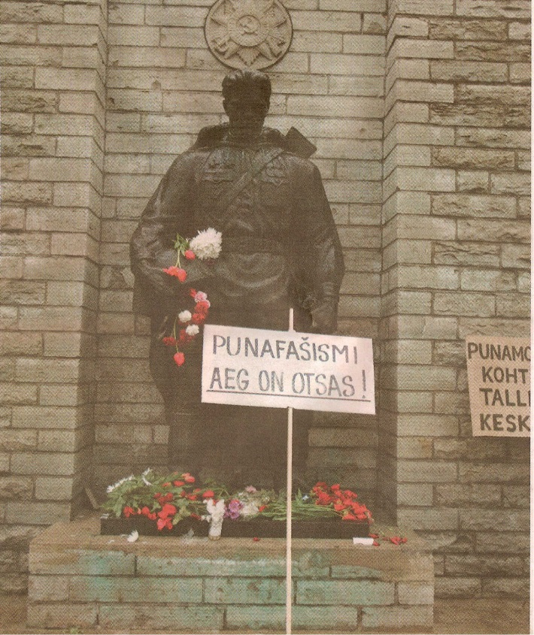
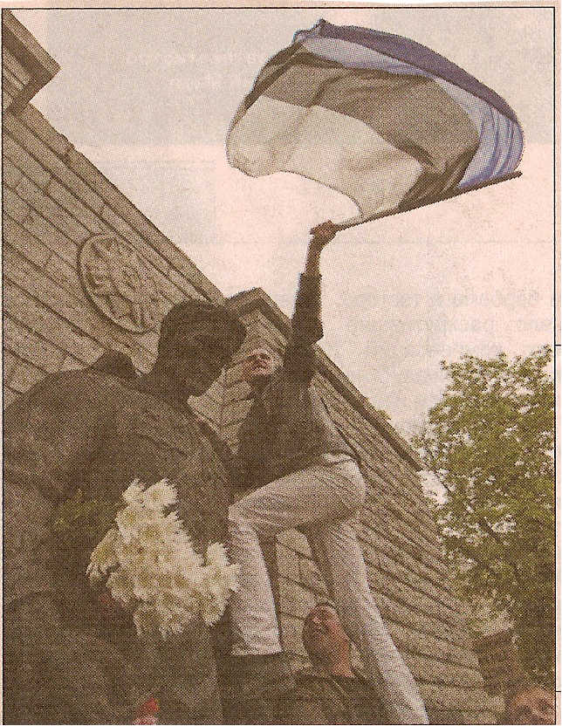
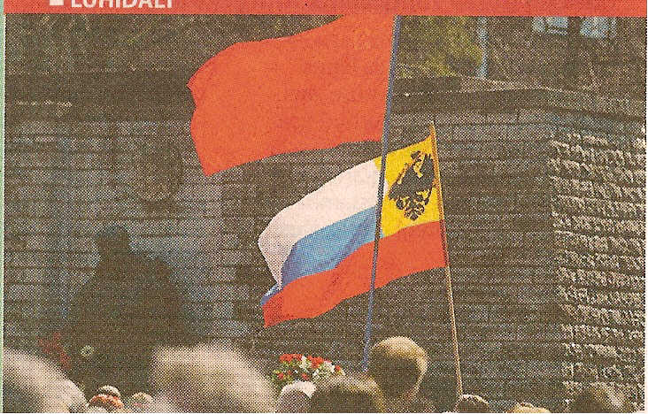

Slide 10
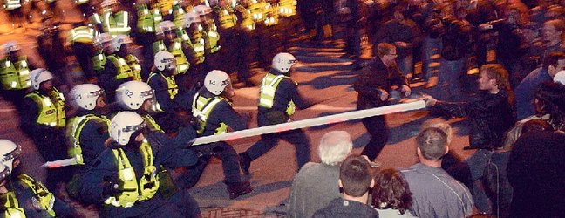
Chairman of the Union of Old Believer communities in Estonia P. Varunin very truly noted: «No Russian politician has done so much to unite Russian community in Estonia, how much did Estonian government’s unreasoned actions during the events connected with the dismantling of the “Bronze Soldier”»

Slide 11
The ruling party of Reforms has received more support of Estonians after monument transferring from Tonismagi that gave it image as a "fighter for justice for Estonians". And first person of party A. Ansip was awarded the Canadian Estonians for participation in the transfer of the Monument to the Liberators of Tallinn.

Slide 12
«Ansip, Velliste and new Nazi»

Slide 13
Events associated with the transfer of the monument, influenced the decision of the Russian people with citizenship:
in 2003 - 1,450 people became citizens of the Russian Federation
in 2004 – 3861,
in 2005 – already 5306,
and in 2006 - 3124.
In 2007 there has been a rapid re-growth in the number of Estonian residents who apply for Russian citizenship: from August 2007 to March 2008 the number of applications for admission to Russian citizenship has increased compared to the same period in 2006-2007 more than twofold.
In 2011, for the first time in Estonia the number of Russian citizens has become more than the number of non-citizens.

Slide 14
Estonia entry into the EU (2004)
According to Eurobarometer, the entry into the EU is perceived by the citizens as a guarantee of the republic's economic and political stability and success: the vast majority of respondents feel themselves more safely (73% Estonians compared to the overall index for the EU 49%) and more politically stable (66% vs. 45% EU) because of the fact that Estonia is a member of the European Union.

Slide 15
Stage result
Formation of orientation to bilingualism among the Russian-speaking population of Estonia, to the integration into the local civil society which was mainly ensured through the knowledge of the language and the acquisition of Estonian citizenship.
Split of society, not only on a national basis, but also within each ethnic group. Thus, among Russians the tendency of similarity of political preferences with preferences of the title nation began to be traced.

Slide 16
The fourth step 2008–2013
New integration program “Estonian Integration Strategy 2008–2013” was developed, according to which the integration process should be focused on formation and strengthening of the state identity of Estonia, development general understanding of the state based on the constitutional values ​​of Estonia as a democratic state; on advantage of being a citizen of Estonia; recognition of each citizen’s contribution in society development and recognition of cultural distinctions.

Slide 17
The fifth step 2014-2020
Аttempt to develop a new state integration program “Lõimuv Eesti 2020” (“Interwoven Estonia 2020”)
Creation of discussion tables for identification of ethnic problems

Slide 18
February 19, 2012 Congress of the Social Democratic Party of Estonia decided to merge with the Russian Party of Estonia. Thus, in Estonia disappeared last party with the word "Russian" in the title.

Slide 19
Briefly conclusions:
The integration programs and initiatives caused ambiguous reaction due to the fact that instead of the previously used concepts ("Estonian citizens of other nationalities", "national minorities", "people whose mother tongue is not Estonian") is now being used “the inhabitants of immigration origin” (immigranttaustaga elanikud).
Integration programs should primarily be directed to the Estonians, because Russian-speaking population of Estonia today is much more tolerant and loyal.

Slide 20
Thank for your attention
Khalliste Olga
Department of Sociology, St. Petersburg State Institute of Technology, Saint-Petersburg, Russia

